Slide 1
Welcome to Montpellier
OMA TestFest
Village by CA
621 Rue Georges Méliès
34000 Montpellier
http://www.ioterop.com
IoTerop Tel: +33 (0)4 67 13 00 69
sabrina.lurie@ioterop.com

Slide 2
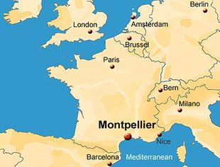
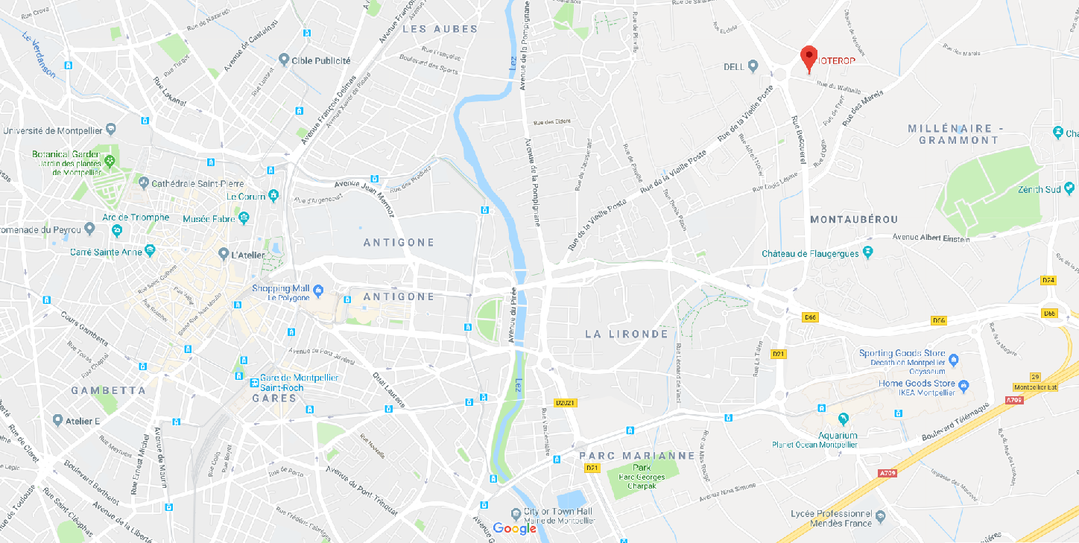
MAP OF MONTPELLIER
Millénaire
Grammont
Antigone
Mosson
Old
Downtown
Shopping Mall
Station Antigone
Novotel Antigone
Ibis Centre Antigone
Mercure Antigone Centre
Mercure Comedie Centre
Pullman
Station TRAM Place de l’Europe
Tram Line 1 (Blue)
Odysseum Terminal
Or
Mosson Terminal
Village by CA OMA TestFest
Train Station
St Roch
Odysseum
Shopping Mall
Airport
15-20 min.
New
Residential area
Taxi or Uber
Station TRAM Moulares
Bus Line 9
Grammont
Or
Apollo
Courtyard by Marriott

Slide 3
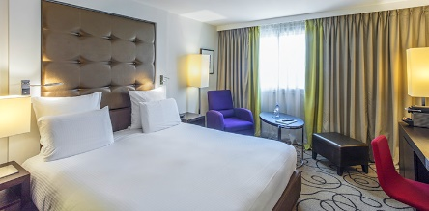
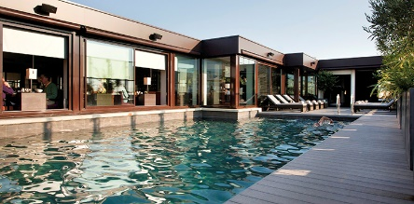
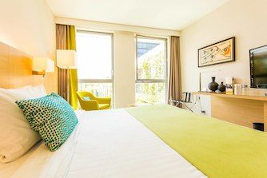
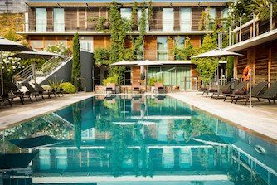
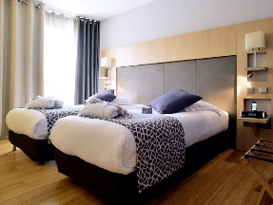
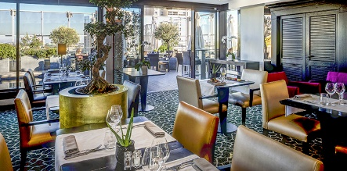
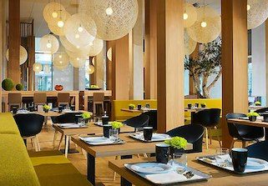
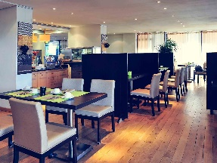
HOTEL PULLMAN MONTPELLIER
HOTEL COURTYARD BY MARRIOTTCENTRE
HOTEL MERCURE COMEDIE CENTRE
1 Rue des Pertuisanes 34000 Montpellier
Tel: +33 (0)4 67 99 72 72
Guests’ review 4.5 out of 5.0
Price average
125-170€
105 Place Georges Freche (Rue du Chelia), 34000 Montpellier
Tel: +33 (0)4 99 54 74 00
Guests’ review 4.4 out of 5.0
6 Rue de la Spirale 34000 Montpellier Tel: +33 (0)4 67 99 89 89
Guests’ review 3.5 out of 5.0
Price average
100-150€
Price average
165-200+€
The Pullman Montpellier Centre hotel is located in the heart of the historic center near Place de la Comédie, the Polygone business district, Le Corum convention center, Zénith and the arena. The hotel offers upscale services ideal for business trips and getaways. The hotel has direct access to parking. On the rooftop terrace, there is a pool and restaurant with a panoramic view. High-tech meeting rooms are also available at the hotel.
SERVICES OFFERED BY THE HOTEL
. Pullman Welcomer
. Internet access
. Connectivity Lounge
. Fitness Lounge
. Access to the pool
. Complimentary mineral water in the room
. Parking
Welcome to Courtyard Montpellier, an inviting Montpellier hotel located directly next to city hall which is designed by a famous architect Jean Nouvel. As the most exciting hotel Montpellier has to offer, we are just steps from lively downtown shops and restaurants. The historical center, convention center, Fabre Museum and all other local city attractions of Montpellier are just a few tramway stops away. At Courtyard Montpellier, we know how to treat travelers and that you want more convenience on the road. Now, you can relax and work on your terms with our newly designed lobby space. Enjoy succulent Mediterranean food at Oleo Pazzo Mediterranean Bistro in a relaxed and contemporary atmosphere. As one of the most innovative hotels in Montpellier, our public areas are equipped with Wi-Fi, relaxing media pods, large HD TVs, and our new GoBoard with all the sports, weather, news, local information and more to keep you up-to-date.
Located a short walk from the Corum convention center and business district, only 10 minutes from the train station and 15 min from the beaches, the Mercure Montpellier Centre Comédie hotel offers all the services you would expect for business or leisure travel. All of its rooms are both designer and comfortable. When it's time for a gourmet break, discover authentic regional cuisine at our hotel's brasserie, or relax on the sunny terrace with a cooling spray.
The Mercure Montpellier Centre Comédie hotel is the ideal place to stay if you want to combine pleasure, relaxation and work. Explore this bustling city that is home to some of the world's greatest heritage sites.

Slide 4
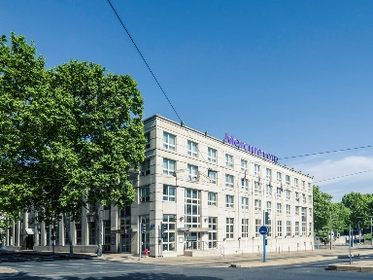
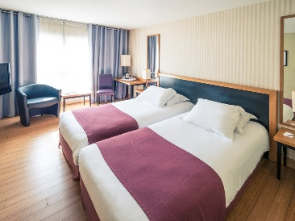
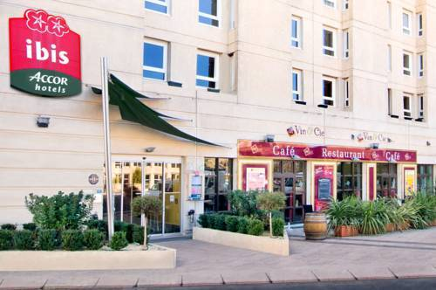
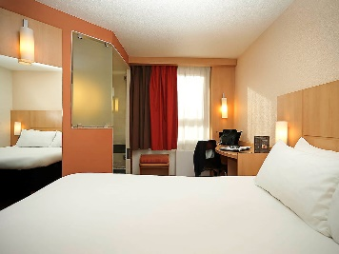
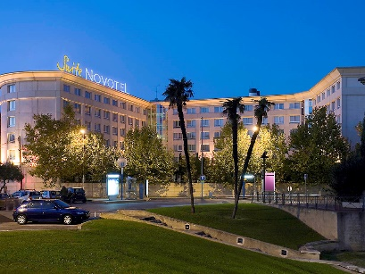
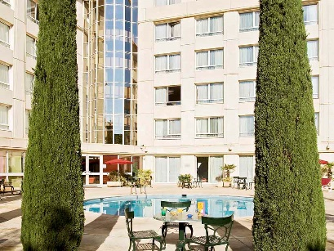
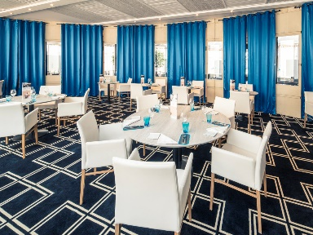
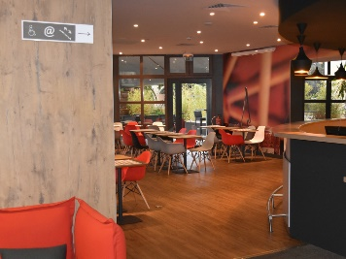
IBIS MONTPELLIER CENTRE
NOVOTEL SUITES MONTPELLIER HOTEL
HOTEL MERCURE ANTIGONE CENTRE
95 Place Vauban
Boulevard d’Antigone 34000 Montpellier
Tel: +33 (0)4 67 64 06 64 Guests’ review 3.0 out of 5.0
Price average
80-120€
45 Av. du Pirée 34000 Montpellier
Tel: +33 (0)4 67 20 57 57 Guests’ review 3.5 out of 5.0
Price average
85-110€
285 Bld de l’Aéroport International – Antigone 34000 Montpellier
Tel: +33 (0)4 67 20 63 63
Guests’ review 3.5 out of 5.0
Price average
90-130€
Close to Place de la Comédie, the Polygone shopping mall, Le Corum and St. Roch train station, the ibis Montpellier Centre hotel offers direct access by car or public transport to the Millénaire business park, Le Zénith, the airport, Aréna, the exhibition center and the beaches in 10 minutes. The hotel is perfect for your business trips or vacations with its 125 cozy, air-conditioned rooms, free WIFI, 24-hour bar, restaurant, 3 meeting rooms for seminars, sunny terraces and private paying parking garage.
Town center, close to the town hall, Polygone shopping center and Corum conference center, and historic center. Beaches 10 minutes away and the Odysseum-Millénaire leisure complex 5 mins away.
Offering rooms and versatile 35 m² suites that can be transformed into meeting spaces, Novotel Suites Montpellier has one goal: to make sure your stay is as relaxing and comfortable as possible. This welcoming hotel in Montpellier has a bar, a gourmet boutique and daily buffet breakfast, as well as a heated outdoor swimming pool, a fitness room and free revitalising sessions on Tuesday and Thursday evenings. Unwind over a game of ping pong, or borrow one of our Smart cars to explore the city!
Situated in the Antigone district, our hotel makes it so easy to get around, thanks to our car park, garage and proximity to trams, buses and the airport shuttle. Visit the Place de l'Europe and Place de la Comédie, go shopping at Polygone and Odysseum, a nd dive into the Antigone Olympic Swimming Pool. Business travellers appreciate our location near the CORUM conference centre, exhibition centre and the Millénaire district, while the nearby motorway provides easy access to the sea and Camargue region.
Located in Montpellier city center and close to the beaches, the 4-star Mercure Montpellier Centre Antigone hotel is just a stone's throw away from the Place de la Comédie and the Odysseum leisure center. If on business, you will appreciate the proximity of our hotel to the Corum business district, the conference center and the Arena. Enjoy relaxing on the restaurant patio and sample our tasty menu, combining sophistication and Mediterranean notes. Satisfaction guaranteed!
Located close to public transport links, the Mercure Montpellier Antigone is an ideal base for exploring Montpellier's shops, culture and numerous attractions, including the Fabre museum, the Planetarium and the Aquarium.

Slide 5
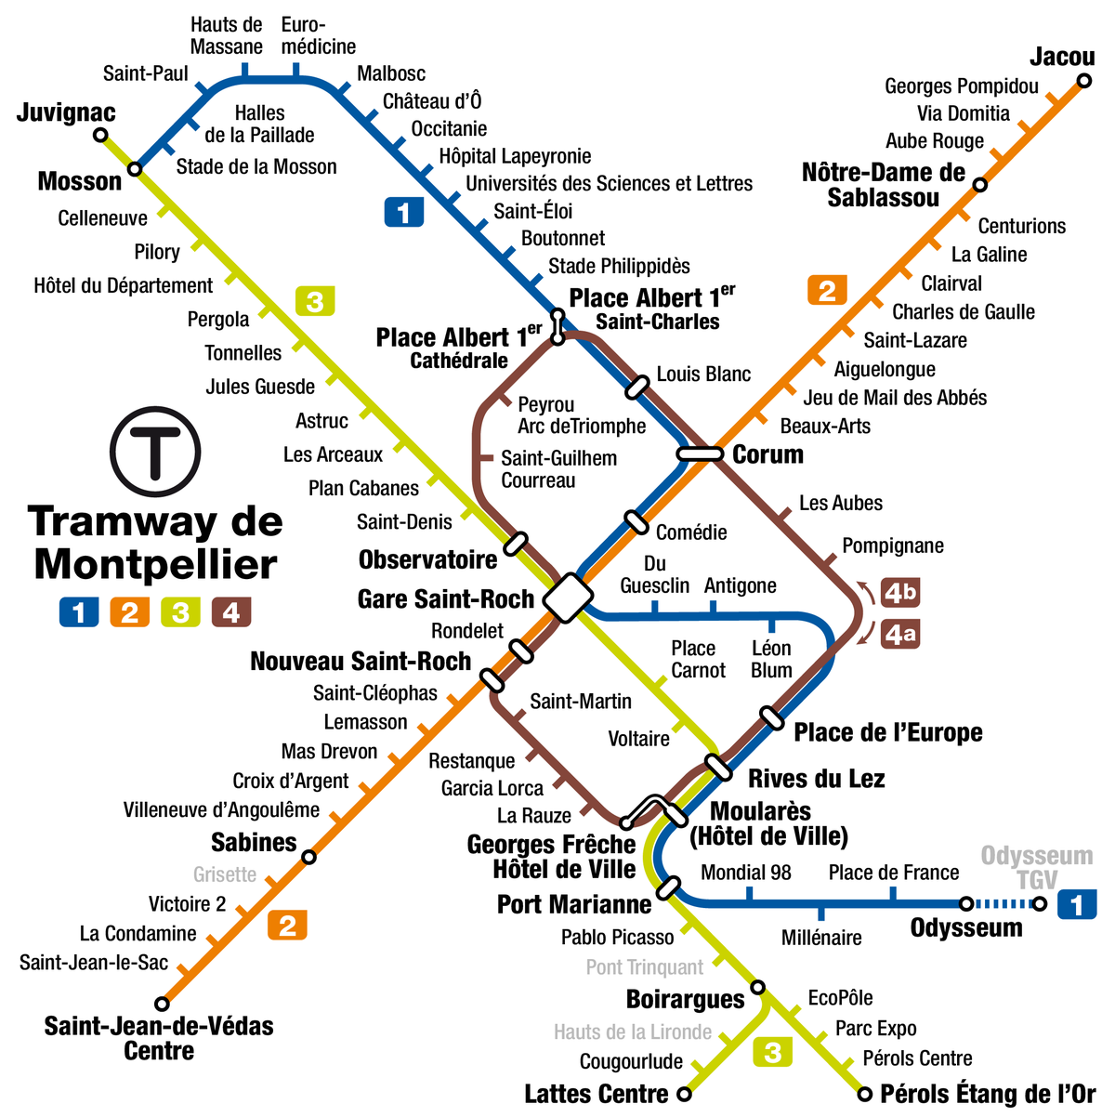
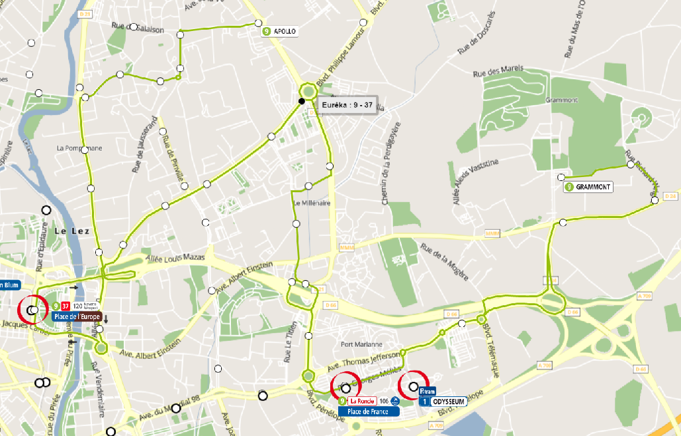
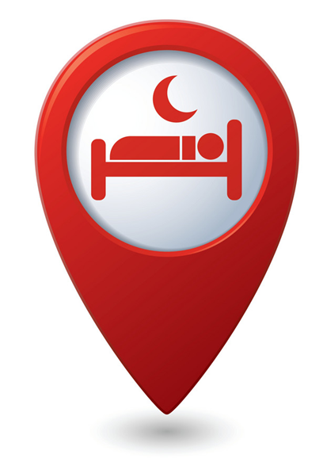
MONTPELLIER TRAM LINES
MONTPELLIER TRAM BLUE LINE n°1
From the Hotels to OMA TestFest
Take Tram 1 (blue line) to Odysseum. Exist last stop (terminus)
From OMA TestFest to the Hotels
Take Tram 1 (blue line) to Mosson and exit stations:
Moulares for the Courtyard by Marriott
Léon Blum for Mercure Antigone and Novotel Suites
Du Guesclin for Mercure Comédie, Pullman and Ibis Centre Hôtel
Mercure Comédie, Pullman & Ibis
Mercure Antigone & Novotel Suites
Courtyard by Marriott
Village by CA
OMA TestFest

Slide 6
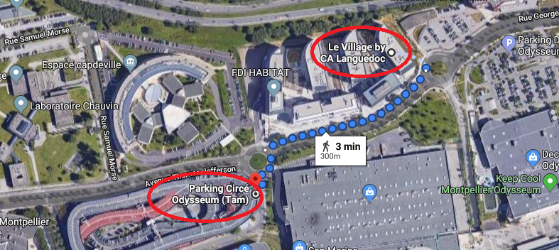
TRAM STATION ODYSSEUM TO OMA TESTFEST SITE (Village by CA)
300 meters walking distance
Village by CA
621 Rue Georges Méliès
34000 Montpellier

Slide 7
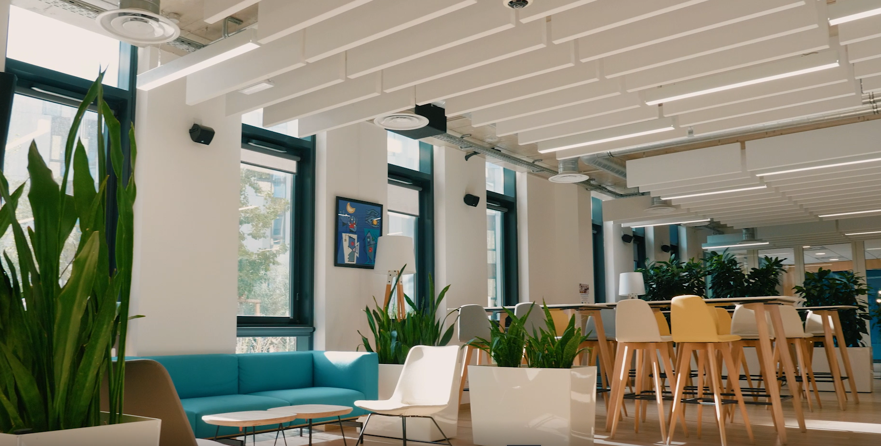
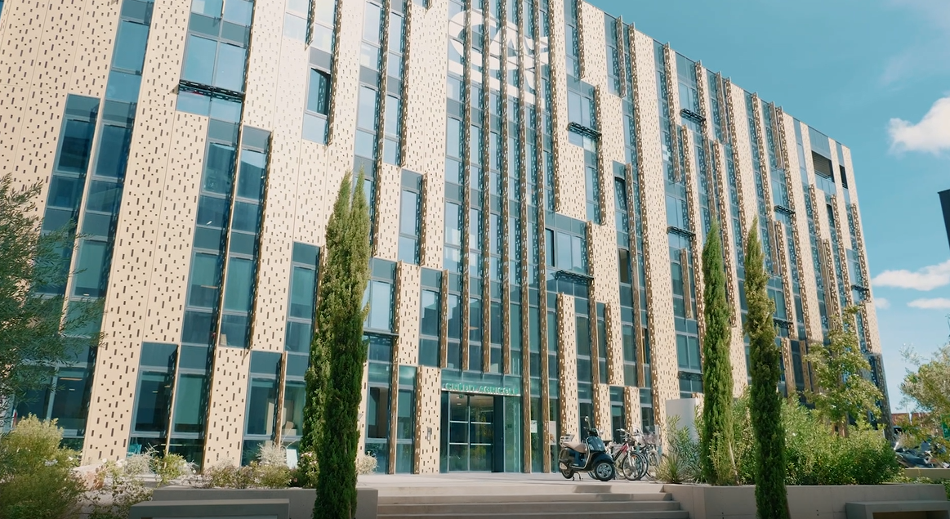
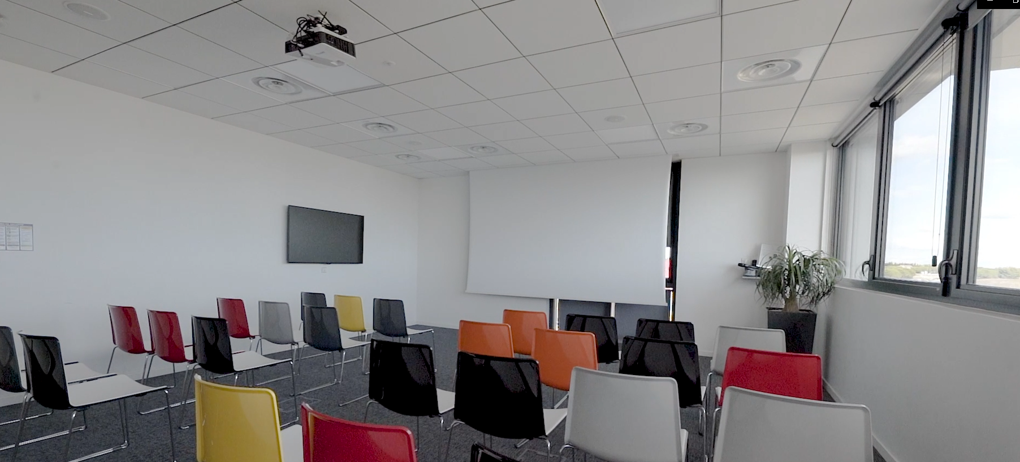
OMA TeStFest montpellier
Village by CA
621 Rue Georges Méliès
34000 Montpellier

Slide 8
We look forward
http://www.ioterop.com
to seeing you

